Slide 1
ALGORITHM APPROACH FOR SOLVING TIME-FRACTIONAL COUPLED SYSTEMS OF PARTIAL DIFFERENTIAL EQUATIONS
Falade Kazeem Iyanda PhD
Associate Professor of Numerical and Computational Mathematics
DEPARTMENT OF MATHEMATICS, FACULTY OF COMPUTING AND MATHEMATICAL SCIENCES, ALIKO DANGOTE UNIVERSITY OF SCIENCE AND TECHNOLOGY
, WUDIL KANO NIGERIA.
OCTOBER, 2024

Slide 2
ABSTRACT
In this paper, we introduced and applied an efficient computational algorithm utilizing the capabilities of the Maple 18 software package, incorporating the coded fractional derivatives in the Riemann-Liouville sense. Our focus is on solving coupled systems of partial differential equations commonly encountered in engineering and mathematical physics such as, fluid dynamics, viscoelastic materials, viscous damping, polymer physics, and just to mention a few. Our proposed algorithm used various mathematical commands within the Maple software package. We presented four illustrative examples of both linear and nonlinear time-fractional coupled systems of partial differential equations. The obtained results are systematically compared with analytical solutions to assess their accuracy. These findings are presented in both tabular format and as 2D and 3D graphical representations. The proposed algorithm is characterized by its ease of use, reliability, and efficiency. It holds the potential to serve as a valuable mathematical tool for addressing a wide range of systems of partial differential equations in applied mathematics.

Slide 3
INTRODUCTION
Time-fractional partial differential equations have garnered significant attention in the areas of engineering and applied mathematics. its application to model various physical processes such as heat conduction in composite materials, non-Newtonian fluid flow, and visco-elastic behavior in structural elements is growing [1,2,3,4].
This paper presents and applies computational technique to solve linear and non-linear systems in two dimensions that result from time-fraction partial differential equations in damping, seismic analysis, and visco-elastic materials [5, 6].

Slide 4
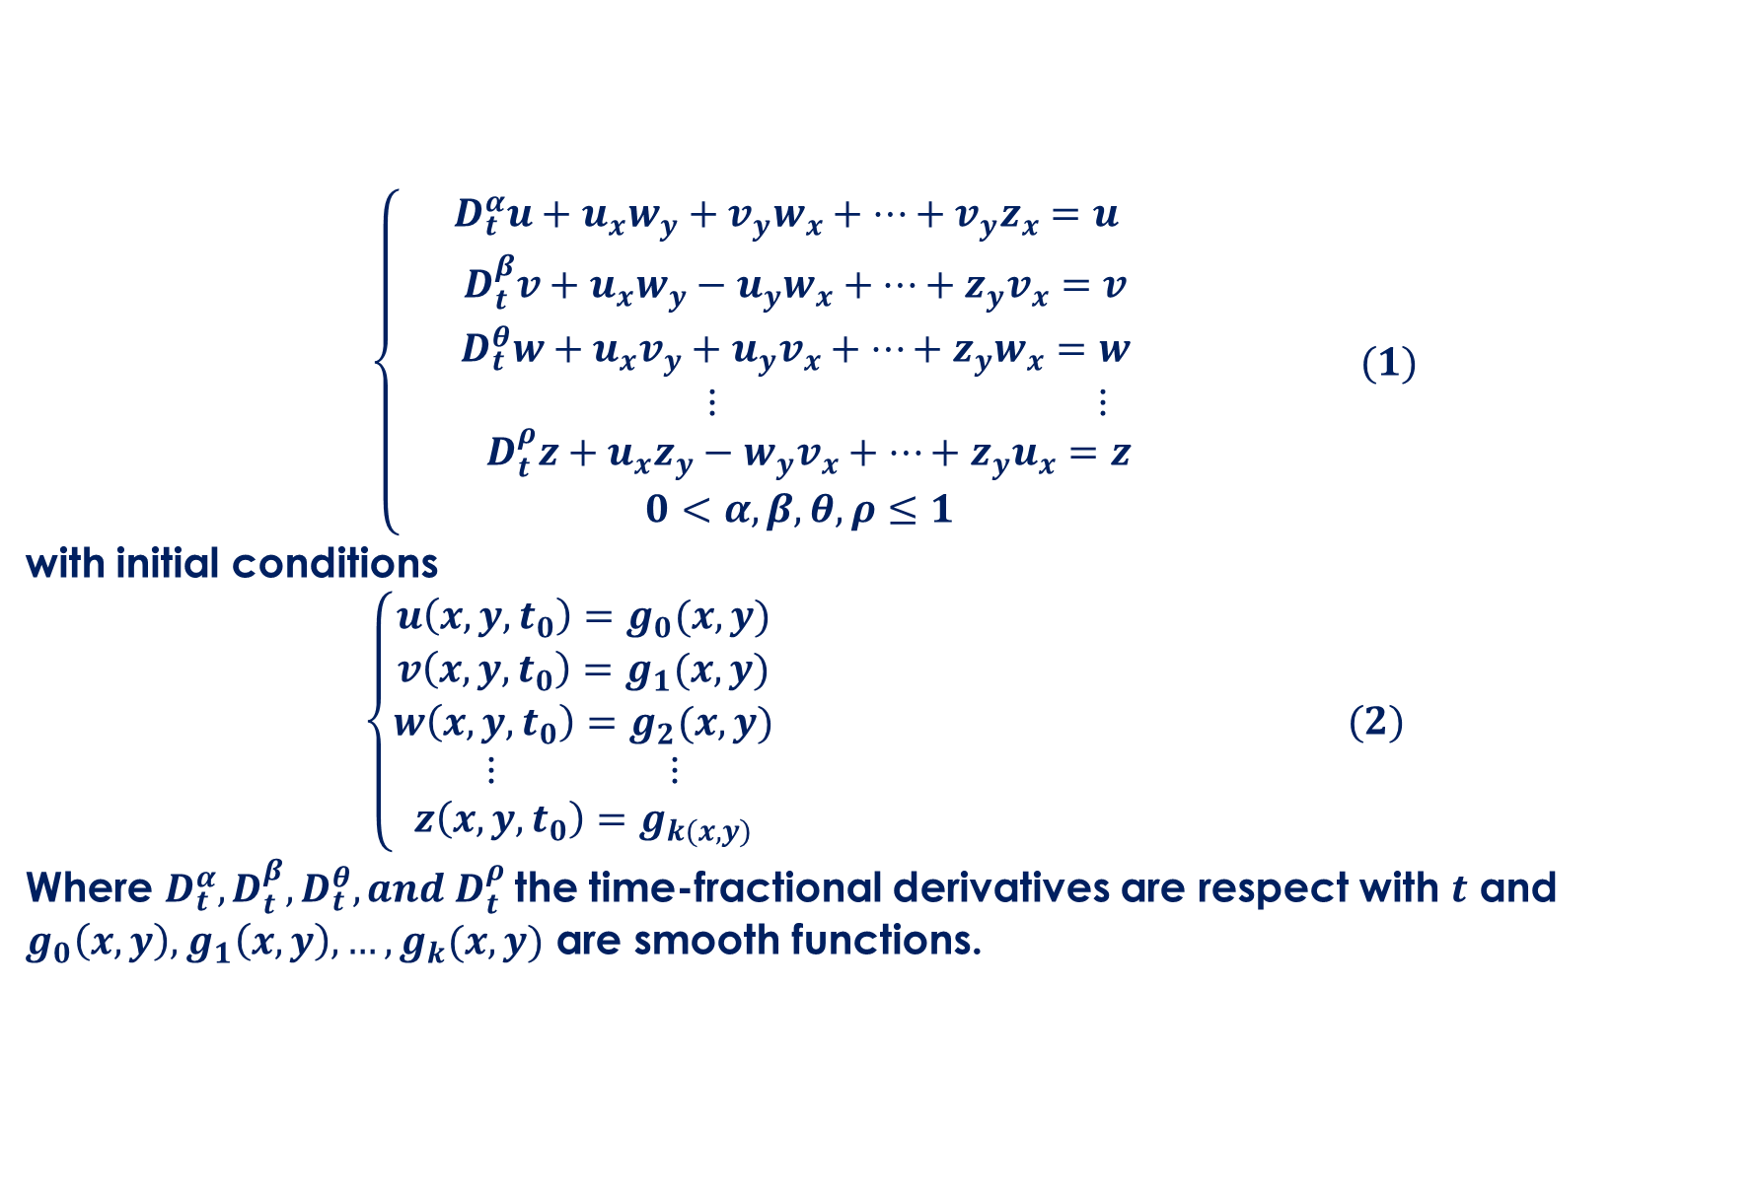
$\left\{\begin{aligned}\begin{aligned}{ D}_{t}^{α}u+u_{x}w_{y}+v_{y}w_{x}+…+v_{y}z_{x}=u \\ D_{t}^{β}v+u_{x}w_{y}−u_{y}w_{x}+…+z_{y}v_{x}=v \\ D_{t}^{θ}w+u_{x}v_{y}+u_{y}v_{x}+…+z_{y}w_{x}=w \\ ⋮ ⋮ \\ D_{t}^{ρ}z+u_{x}z_{y}−w_{y}v_{x}+…+z_{y}u_{x}=z \end{aligned} \\ 0<α,β,θ,ρ≤1 \end{aligned}\right. (1)$
with initial conditions
$$\left\{\begin{aligned}u\left(x,y,t_{0}\right)=g_{0}(x,y) \\ v\left(x,y,t_{0}\right)=g_{1}(x,y) \\ w\left(x,y,t_{0}\right)=g_{2}(x,y) \\ ⋮ ⋮ \\ z\left(x,y,t_{0}\right)=g_{k(x,y)}\end{aligned}\right. (2)$$
Where $D_{t}^{α},D_{t}^{β},D_{t}^{θ},and D_{t}^{ρ}$the time-fractional derivatives are respect with $t$ and $g_{0}\left(x,y\right),g_{1}\left(x,y\right),…,g_{k}(x,y)$ are smooth functions.

Slide 5
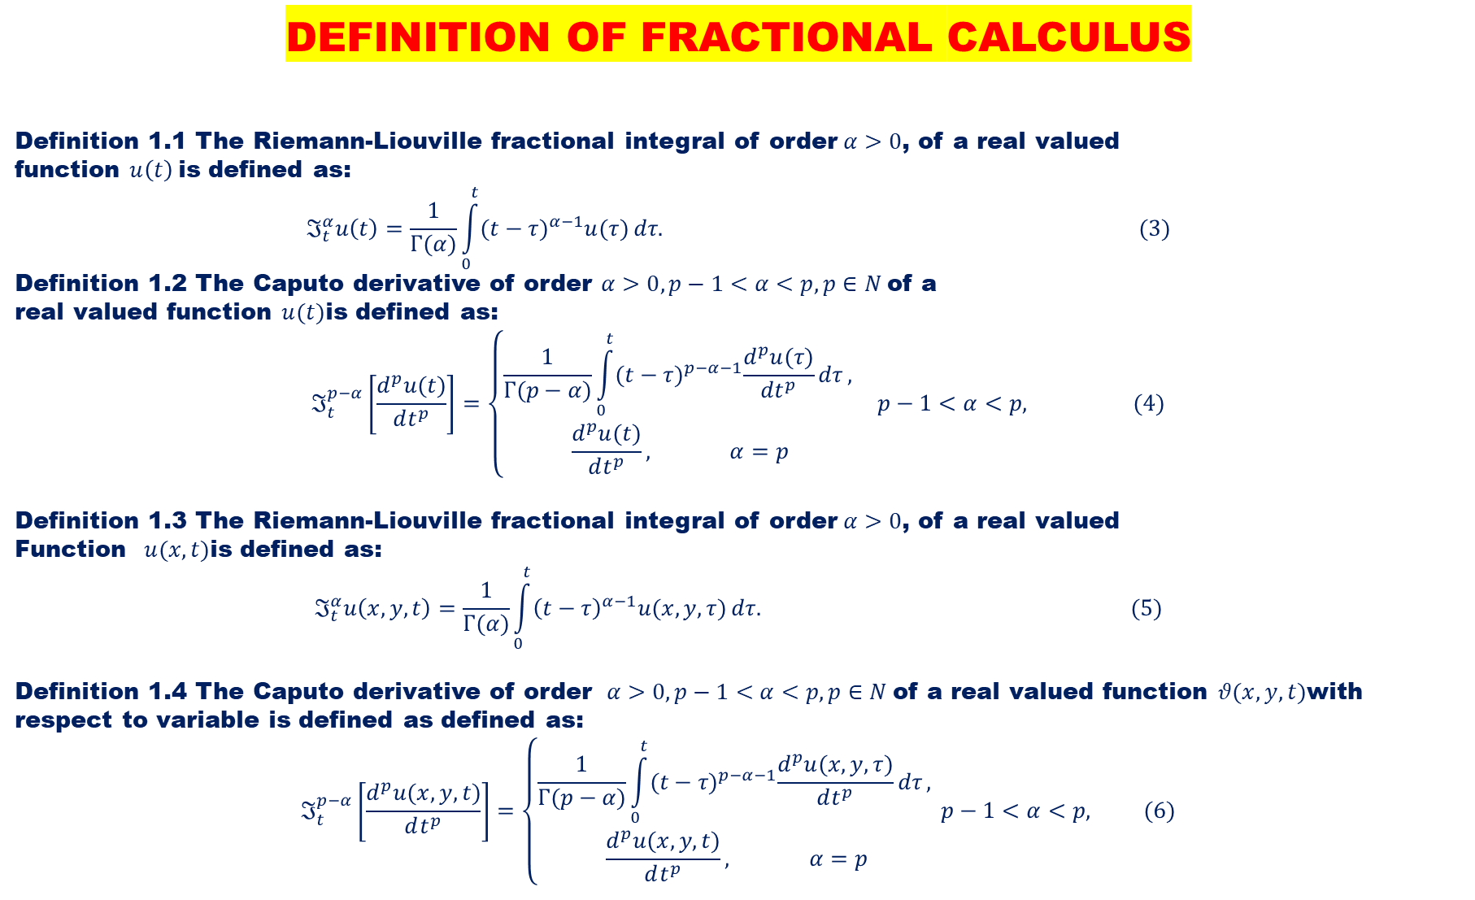
DEFINITION OF FRACTIONAL CALCULUS
Definition 1.1 The Riemann-Liouville fractional integral of order$α>0$, of a real valued
function $u\left(t\right)$is defined as:
$$ℑ_{t}^{α}u\left(t\right)=\frac{1}{Γ(α)}\int_{0}^{t}{{(t−τ)}^{α−1}u(τ)}dτ. (3)$$
Definition 1.2 The Caputo derivative of order $α>0,p−1<α<p,p∈N$of a
real valued function $u(t)$is defined as:
$$ℑ_{t}^{p−α}\left[\frac{d^{p}u(t)}{dt^{p}}\right]=\left\{\begin{aligned}\frac{1}{Γ(p−α)}\int_{0}^{t}{{(t−τ)}^{p−α−1}\frac{d^{p}u(τ)}{dt^{p}}dτ}, \\ \frac{d^{p}u(t)}{dt^{p}}, α=p\end{aligned}\right. p−1<α<p, (4)$$
Definition 1.3 The Riemann-Liouville fractional integral of order$α>0$, of a real valued
Function $u(x,t)$is defined as:
$$ℑ_{t}^{α}u\left(x,y,t\right)=\frac{1}{Γ(α)}\int_{0}^{t}{{\left(t−τ\right)}^{α−1}u(x,y,τ)}dτ. (5)$$
Definition 1.4 The Caputo derivative of order $α>0,p−1<α<p,p∈N$of a real valued function $θ(x,y,t)$with respect to variable is defined as defined as:
$$ℑ_{t}^{p−α}\left[\frac{d^{p}u(x,y,t)}{dt^{p}}\right]=\left\{\begin{aligned}\frac{1}{Γ(p−α)}\int_{0}^{t}{{(t−τ)}^{p−α−1}\frac{d^{p}u(x,y,τ)}{dt^{p}}dτ}, \\ \frac{d^{p}u(x,y,t)}{dt^{p}}, α=p\end{aligned}\right.p−1<α<p, (6)$$

Slide 6
LITERATURE REVIEW
In recent years, time-fractional systems of partial differential equations (SFPDEs) have gained increasing prominence as indispensable tools for modeling complex phenomena in the realms of engineering and applied physics. These phenomena encompass a wide spectrum of intricate dynamics, ranging from polymer physics and viscoelastic material behavior to problems involving viscous damping.
Employed numerical methods to address time-fractional coupled systems of partial differential equations [8].
Proposed an efficient computational scheme for nonlinear time-fractional systems of partial differential equations within the realm of physical sciences [9].
Numerical solutions were presented for time-fractional coupled systems of partial differential equations [10].
Used initial-boundary value problems to tackle coupled systems of time-fractional diffusion equations [11].
Reduced differential transform method was applied to provide numerical and approximate solutions for coupled time-fractional nonlinear evolution equations [12].
Presented analytical techniques for systems of time-fractional nonlinear differential equations [13].
Solved a system of fractional partial differential equations relevant to the model of HIV infection of CD4+T cells and one-dimensional Keller-Segel equations [14].

Slide 7
DESCRIPTIONS OF THE COMPUTATIONAL ALGORITHM
TEN-STEP ALGORITHM FOR THE TWO-DIMENSIONAL NON-LINEAR SYSTEM OF THE TIME-FRACTION PARTIAL DIFFERENTIAL EQUATIONS
We consider three by three form of equation (1) coupled with initial condition (2) to formulate a ten-step algorithm using Maple 18 a coded command as follows:

Slide 8
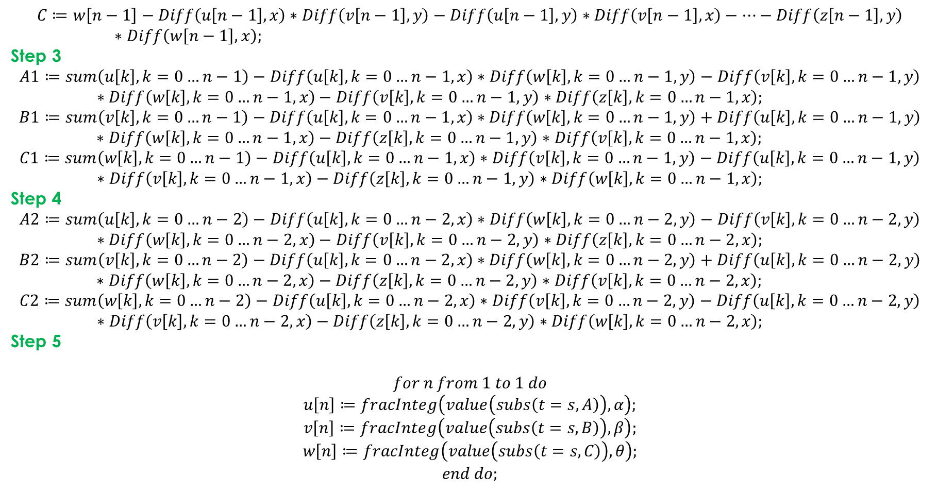
$$C≔w\left[n−1\right]−Diff\left(u\left[n−1\right],x\right)∗Diff\left(v\left[n−1\right],y\right)−Diff\left(u\left[n−1\right],y\right)∗Diff\left(v\left[n−1\right],x\right)−…−Diff\left(z\left[n−1\right],y\right)∗Diff\left(w\left[n−1\right],x\right);$$
Step 3
$$A1≔sum\left(u\left[k\right],k=0…n−1\right)−Diff\left(u\left[k\right],k=0…n−1,x\right)∗Diff\left(w\left[k\right],k=0…n−1,y\right)−Diff\left(v\left[k\right],k=0…n−1,y\right)∗Diff\left(w\left[k\right],k=0…n−1,x\right)−Diff\left(v\left[k\right],k=0…n−1,y\right)∗Diff\left(z\left[k\right],k=0…n−1,x\right);$$
$$B1≔sum\left(v\left[k\right],k=0…n−1\right)−Diff\left(u\left[k\right],k=0…n−1,x\right)∗Diff\left(w\left[k\right],k=0…n−1,y\right)+Diff\left(u\left[k\right],k=0…n−1,y\right)∗Diff\left(w\left[k\right],k=0…n−1,x\right)−Diff\left(z\left[k\right],k=0…n−1,y\right)∗Diff\left(v\left[k\right],k=0…n−1,x\right);$$
$$C1≔sum\left(w\left[k\right],k=0…n−1\right)−Diff\left(u\left[k\right],k=0…n−1,x\right)∗Diff\left(v\left[k\right],k=0…n−1,y\right)−Diff\left(u\left[k\right],k=0…n−1,y\right)∗Diff\left(v\left[k\right],k=0…n−1,x\right)−Diff\left(z\left[k\right],k=0…n−1,y\right)∗Diff\left(w\left[k\right],k=0…n−1,x\right);$$
Step 4
$$A2≔sum\left(u\left[k\right],k=0…n−2\right)−Diff\left(u\left[k\right],k=0…n−2,x\right)∗Diff\left(w\left[k\right],k=0…n−2,y\right)−Diff\left(v\left[k\right],k=0…n−2,y\right)∗Diff\left(w\left[k\right],k=0…n−2,x\right)−Diff\left(v\left[k\right],k=0…n−2,y\right)∗Diff\left(z\left[k\right],k=0…n−2,x\right);$$
$$B2≔sum\left(v\left[k\right],k=0…n−2\right)−Diff\left(u\left[k\right],k=0…n−2,x\right)∗Diff\left(w\left[k\right],k=0…n−2,y\right)+Diff\left(u\left[k\right],k=0…n−2,y\right)∗Diff\left(w\left[k\right],k=0…n−2,x\right)−Diff\left(z\left[k\right],k=0…n−2,y\right)∗Diff\left(v\left[k\right],k=0…n−2,x\right);$$
$$C2≔sum\left(w\left[k\right],k=0…n−2\right)−Diff\left(u\left[k\right],k=0…n−2,x\right)∗Diff\left(v\left[k\right],k=0…n−2,y\right)−Diff\left(u\left[k\right],k=0…n−2,y\right)∗Diff\left(v\left[k\right],k=0…n−2,x\right)−Diff\left(z\left[k\right],k=0…n−2,y\right)∗Diff\left(w\left[k\right],k=0…n−2,x\right);$$
Step 5
$$for n from 1 to 1 do$$
$$u\left[n\right]≔fracInteg\left(value\left(subs\left(t=s,A\right)\right),α\right); \\ v\left[n\right]≔fracInteg\left(value\left(subs\left(t=s,B\right)\right),β\right);$$
$$w\left[n\right]≔fracInteg\left(value\left(subs\left(t=s,C\right)\right),θ\right);$$
$$end do;$$

Slide 9
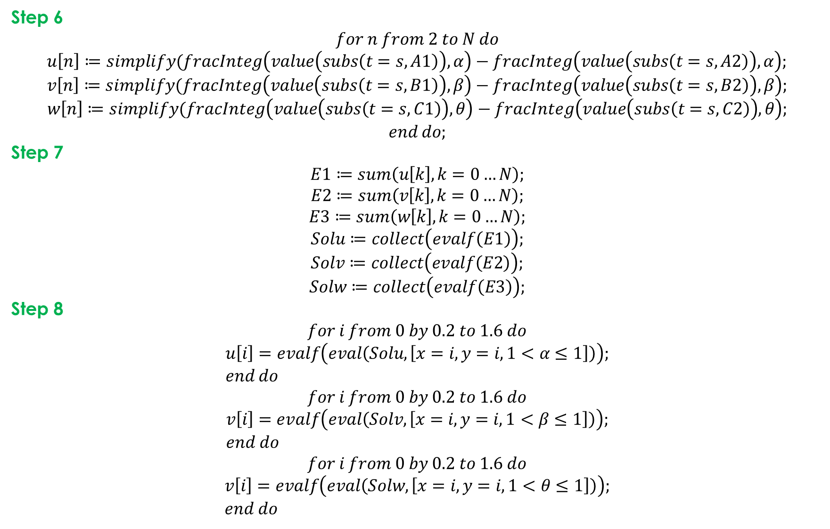
Step 6
$$for n from 2 to N do$$
$$u\left[n\right]≔simplify(fracInteg\left(value\left(subs\left(t=s,A1\right)\right),α\right)−fracInteg\left(value\left(subs\left(t=s,A2\right)\right),α\right); \\ v\left[n\right]≔simplify(fracInteg\left(value\left(subs\left(t=s,B1\right)\right),β\right)−fracInteg\left(value\left(subs\left(t=s,B2\right)\right),β\right);$$
$$w\left[n\right]≔simplify(fracInteg\left(value\left(subs\left(t=s,C1\right)\right),θ\right)−fracInteg\left(value\left(subs\left(t=s,C2\right)\right),θ\right);$$
$$end do;$$
Step 7
$$E1≔sum\left(u\left[k\right],k=0…N\right);$$
$$E2≔sum\left(v\left[k\right],k=0…N\right);$$
$$E3≔sum\left(w\left[k\right],k=0…N\right);$$
$$Solu≔collect\left(evalf\left(E1\right)\right); \\ Solv≔collect\left(evalf\left(E2\right)\right);$$
$$Solw≔collect\left(evalf\left(E3\right)\right);$$
Step 8
$$for i from 0 by 0.2 to 1.6 do$$
$$u\left[i\right]=evalf\left(eval\left(Solu, \left[x=i,y=i,1<α≤1\right]\right)\right); \\ end do$$
$$for i from 0 by 0.2 to 1.6 do$$
$$v\left[i\right]=evalf\left(eval\left(Solv, \left[x=i,y=i,1<β≤1\right]\right)\right); \\ end do$$
$$for i from 0 by 0.2 to 1.6 do$$
$$v\left[i\right]=evalf\left(eval\left(Solw, \left[x=i,y=i,1<θ≤1\right]\right)\right); \\ end do$$

Slide 10
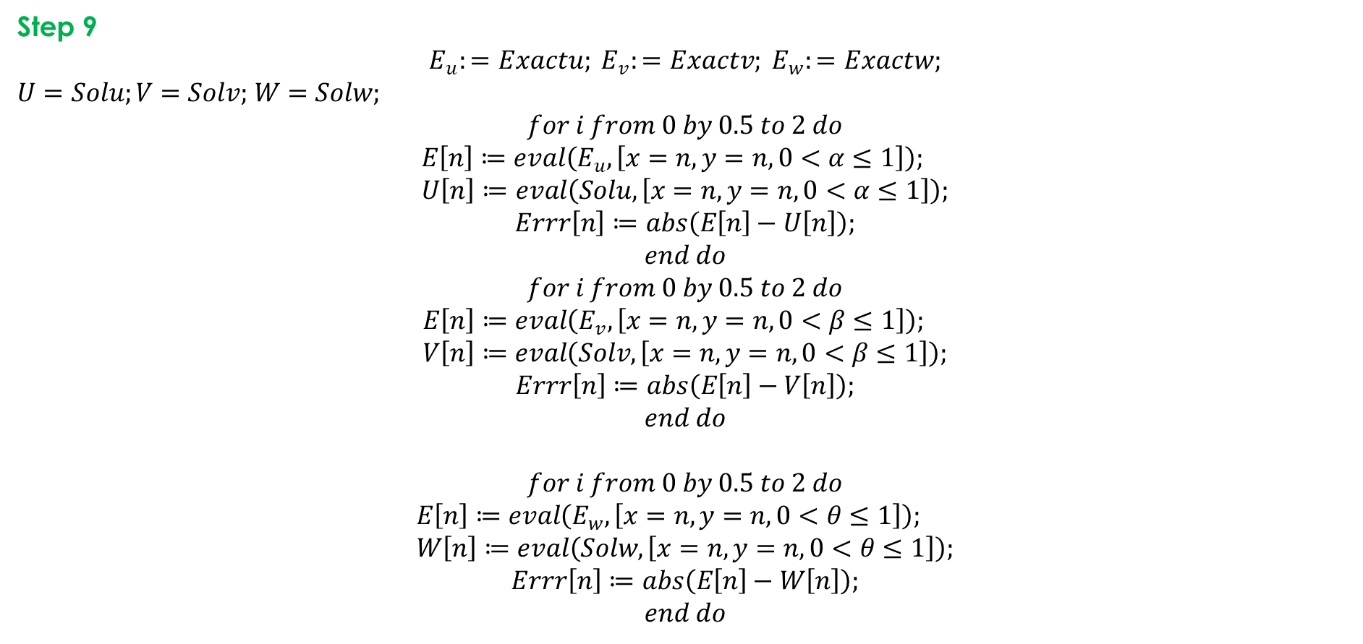
Step 9
$$E_{u}:=Exactu; E_{v}:=Exactv; E_{w}:=Exactw;$$
$U=Solu;V=Solv;$ $W=Solw;$
$$for i from 0 by 0.5 to 2 do$$
$$E\left[n\right]≔eval\left(E_{u},\left[x=n,y=n, 0<α≤1\right]\right); \\ U\left[n\right]≔eval\left(Solu,\left[x=n,y=n, 0<α≤1\right]\right);$$
$$Errr\left[n\right]≔abs\left(E\left[n\right]−U\left[n\right]\right);$$
$$end do$$
$$for i from 0 by 0.5 to 2 do$$
$$E\left[n\right]≔eval\left(E_{v},\left[x=n,y=n, 0<β≤1\right]\right); \\ V\left[n\right]≔eval\left(Solv,\left[x=n,y=n, 0<β≤1\right]\right);$$
$$Errr\left[n\right]≔abs\left(E\left[n\right]−V\left[n\right]\right);$$
$$end do$$
$$for i from 0 by 0.5 to 2 do$$
$$E\left[n\right]≔eval\left(E_{w},\left[x=n,y=n, 0<θ≤1\right]\right); \\ W\left[n\right]≔eval\left(Solw,\left[x=n,y=n, 0<θ≤1\right]\right);$$
$$Errr\left[n\right]≔abs\left(E\left[n\right]−W\left[n\right]\right);$$
$$end do$$

Slide 11
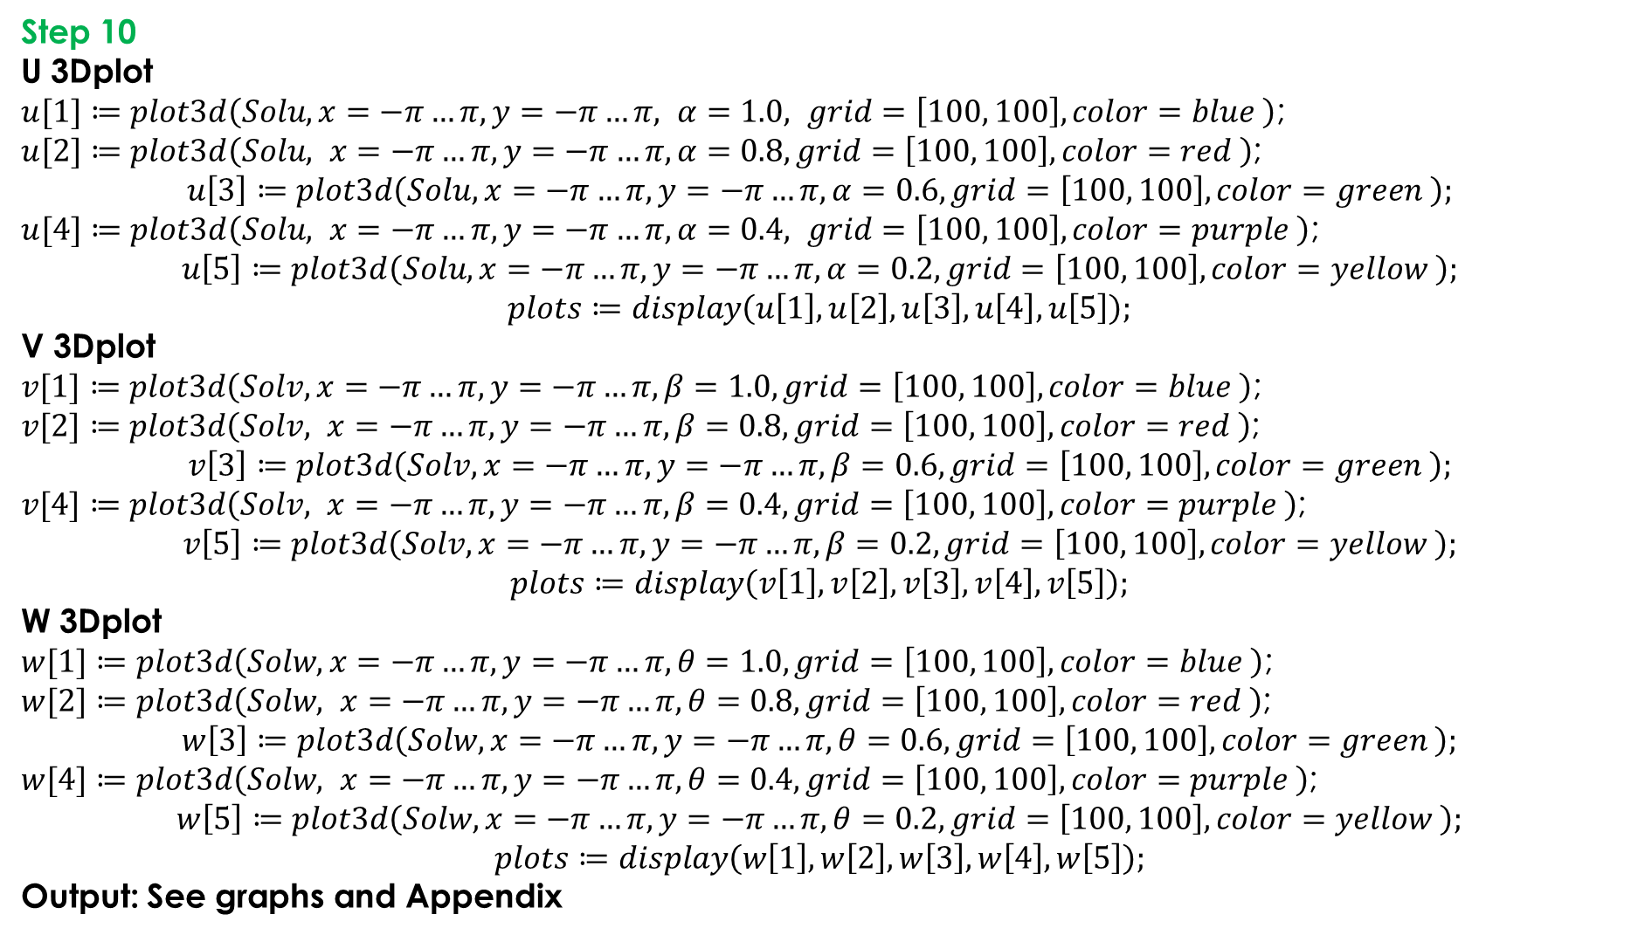
Step 10
U 3Dplot
$u[1]≔plot3d\left(Solu, x=−π…π,y=−π…π, α=1.0, grid=\left[100, 100\right], color=blue \right)$;
$u[2]≔plot3d\left(Solu, x=−π…π,y=−π…π, α=0.8, grid=\left[100, 100\right], color=red \right)$;
$$u\left[3\right]≔plot3d\left(Solu, x=−π…π,y=−π…π,α=0.6, grid=\left[100, 100\right], color=green \right);$$
$u[4]≔plot3d\left(Solu, x=−π…π,y=−π…π,α=0.4, grid=\left[100, 100\right], color=purple \right)$;
$$u\left[5\right]≔plot3d\left(Solu, x=−π…π,y=−π…π, α=0.2, grid=\left[100, 100\right], color=yellow \right);$$
$$plots≔display\left(u\left[1\right], u\left[2\right], u\left[3\right],u\left[4\right],u\left[5\right]\right);$$
V 3Dplot
$v[1]≔plot3d\left(Solv, x=−π…π,y=−π…π, β=1.0, grid=\left[100, 100\right], color=blue \right)$;
$v[2]≔plot3d\left(Solv, x=−π…π,y=−π…π, β=0.8,grid=\left[100, 100\right], color=red \right)$;
$$v\left[3\right]≔plot3d\left(Solv, x=−π…π,y=−π…π, β=0.6,grid=\left[100, 100\right], color=green \right);$$
$v[4]≔plot3d\left(Solv, x=−π…π,y=−π…π, β=0.4,grid=\left[100, 100\right], color=purple \right)$;
$$v\left[5\right]≔plot3d\left(Solv, x=−π…π,y=−π…π, β=0.2,grid=\left[100, 100\right], color=yellow \right);$$
$$plots≔display\left(v\left[1\right], v\left[2\right], v\left[3\right],v\left[4\right],v\left[5\right]\right);$$
W 3Dplot
$w[1]≔plot3d\left(Solw, x=−π…π,y=−π…π, θ=1.0, grid=\left[100, 100\right], color=blue \right)$;
$w[2]≔plot3d\left(Solw, x=−π…π,y=−π…π, θ=0.8,grid=\left[100, 100\right], color=red \right)$;
$$w\left[3\right]≔plot3d\left(Solw, x=−π…π,y=−π…π, θ=0.6,grid=\left[100, 100\right], color=green \right);$$
$w[4]≔plot3d\left(Solw, x=−π…π,y=−π…π, θ=0.4,grid=\left[100, 100\right], color=purple \right)$;
$$w\left[5\right]≔plot3d\left(Solw, x=−π…π,y=−π…π, θ=0.2,grid=\left[100, 100\right], color=yellow \right);$$
$$plots≔display\left(w\left[1\right], w\left[2\right], w\left[3\right],w\left[4\right],w\left[5\right]\right);$$
Output: See graphs and Appendix

Slide 12
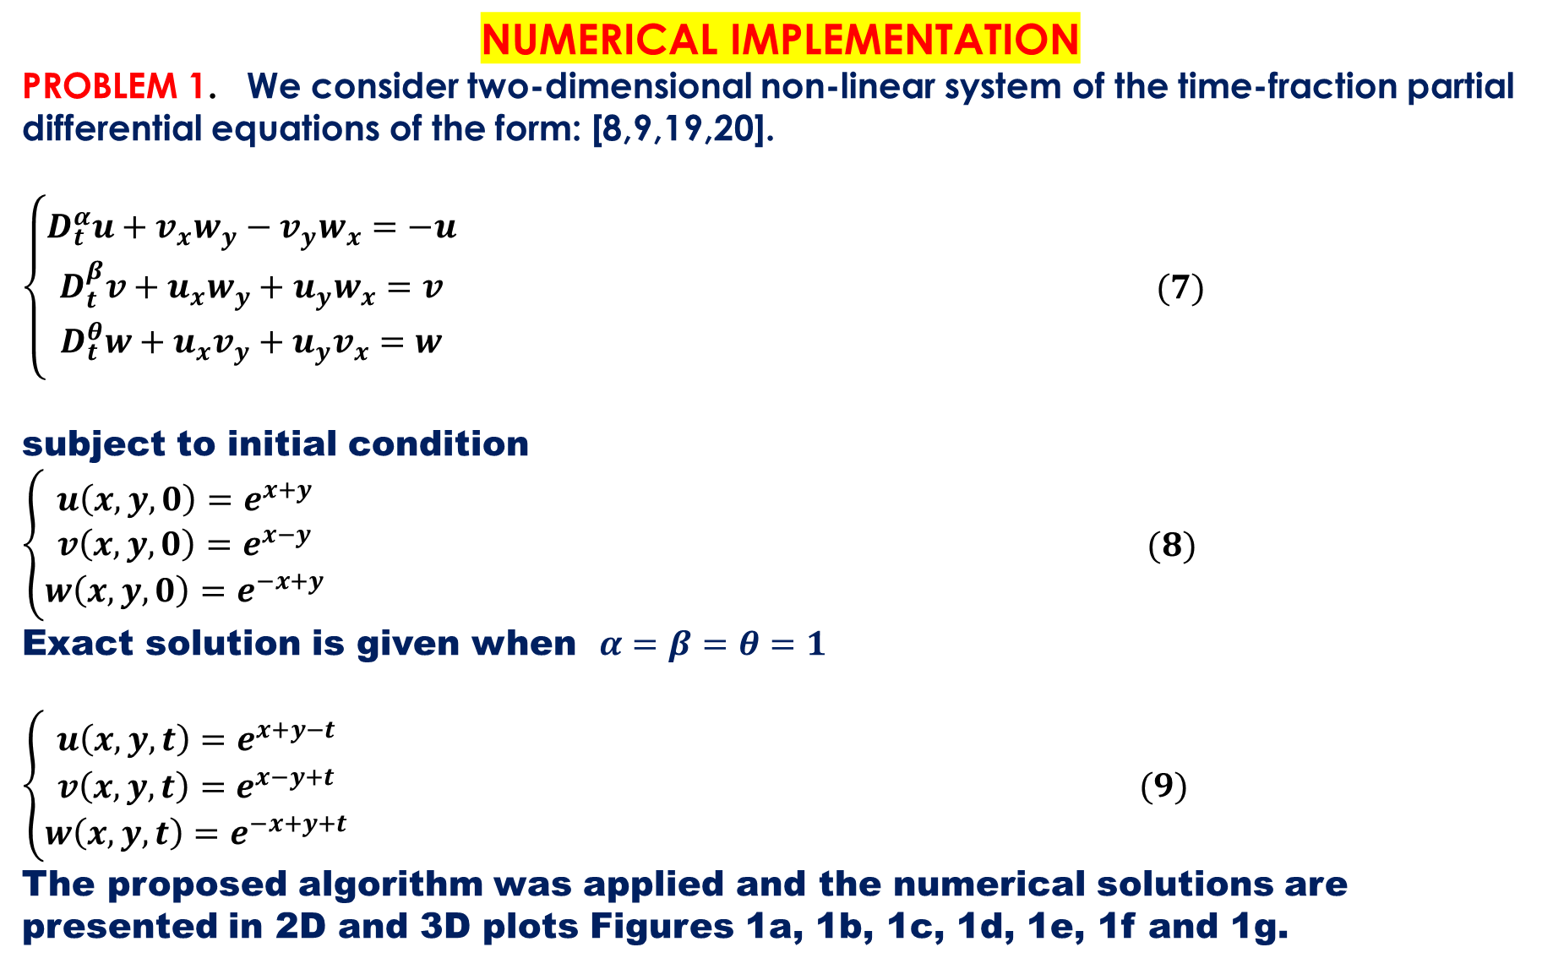
NUMERICAL IMPLEMENTATION
PROBLEM 1. We consider two-dimensional non-linear system of the time-fraction partial differential equations of the form: [8,9,19,20].
$\left\{\begin{aligned}D_{t}^{α}u+v_{x}w_{y}−v_{y}w_{x}=−u \\ D_{t}^{β}v+u_{x}w_{y}+u_{y}w_{x}=v \\ D_{t}^{θ}w+u_{x}v_{y}+u_{y}v_{x}=w\end{aligned}\right. (7)$
subject to initial condition $\left\{\begin{aligned}u\left(x,y,0\right)=e^{x+y} \\ v\left(x,y,0\right)=e^{x−y} \\ w\left(x,y,0\right)=e^{−x+y}\end{aligned}\right. (8)$
Exact solution is given when $α=β=θ=1$
$\left\{\begin{aligned}u\left(x,y,t\right)=e^{x+y−t} \\ v\left(x,y,t\right)=e^{x−y+t} \\ w\left(x,y,t\right)=e^{−x+y+t}\end{aligned}\right. (9)$
The proposed algorithm was applied and the numerical solutions are presented in 2D and 3D plots Figures 1a, 1b, 1c, 1d, 1e, 1f and 1g.

Slide 13
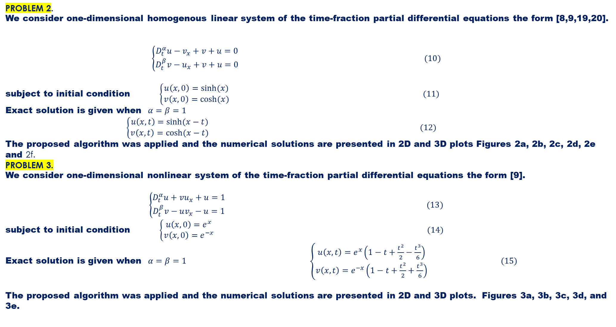
PROBLEM 2.
We consider one-dimensional homogenous linear system of the time-fraction partial differential equations the form [8,9,19,20].
$\left\{\begin{aligned}D_{t}^{α}u−v_{x}+v+u=0 \\ D_{t}^{β}v−u_{x}+v+u=0\end{aligned}\right. (10)$
subject to initial condition $\left\{\begin{aligned}u\left(x,0\right)=sinh⁡(x) \\ v\left(x,0\right)=cosh⁡(x)\end{aligned}\right. (11)$
Exact solution is given when $α=β=1$
$\left\{\begin{aligned}u\left(x,t\right)=sinh⁡(x−t) \\ v\left(x,t\right)=cosh⁡(x−t)\end{aligned}\right. (12)$
The proposed algorithm was applied and the numerical solutions are presented in 2D and 3D plots Figures 2a, 2b, 2c, 2d, 2e and 2f.
PROBLEM 3.
We consider one-dimensional nonlinear system of the time-fraction partial differential equations the form [9].
$\left\{\begin{aligned}D_{t}^{α}u+vu_{x}+u=1 \\ D_{t}^{β}v−uv_{x}−u=1\end{aligned}\right. (13)$
subject to initial condition $\left\{\begin{aligned}u\left(x,0\right)=e^{x} \\ v\left(x,0\right)=e^{−x}\end{aligned}\right. (14)$
Exact solution is given when $α=β=1$ $\left\{\begin{aligned}u\left(x,t\right)=e^{x}\left(1−t+\frac{t^{2}}{2}−\frac{t^{3}}{6}\right) \\ v\left(x,t\right)=e^{−x}\left(1−t+\frac{t^{2}}{2}+\frac{t^{3}}{6}\right)\end{aligned}\right. (15)$
The proposed algorithm was applied and the numerical solutions are presented in 2D and 3D plots. Figures 3a, 3b, 3c, 3d, and 3e.

Slide 14
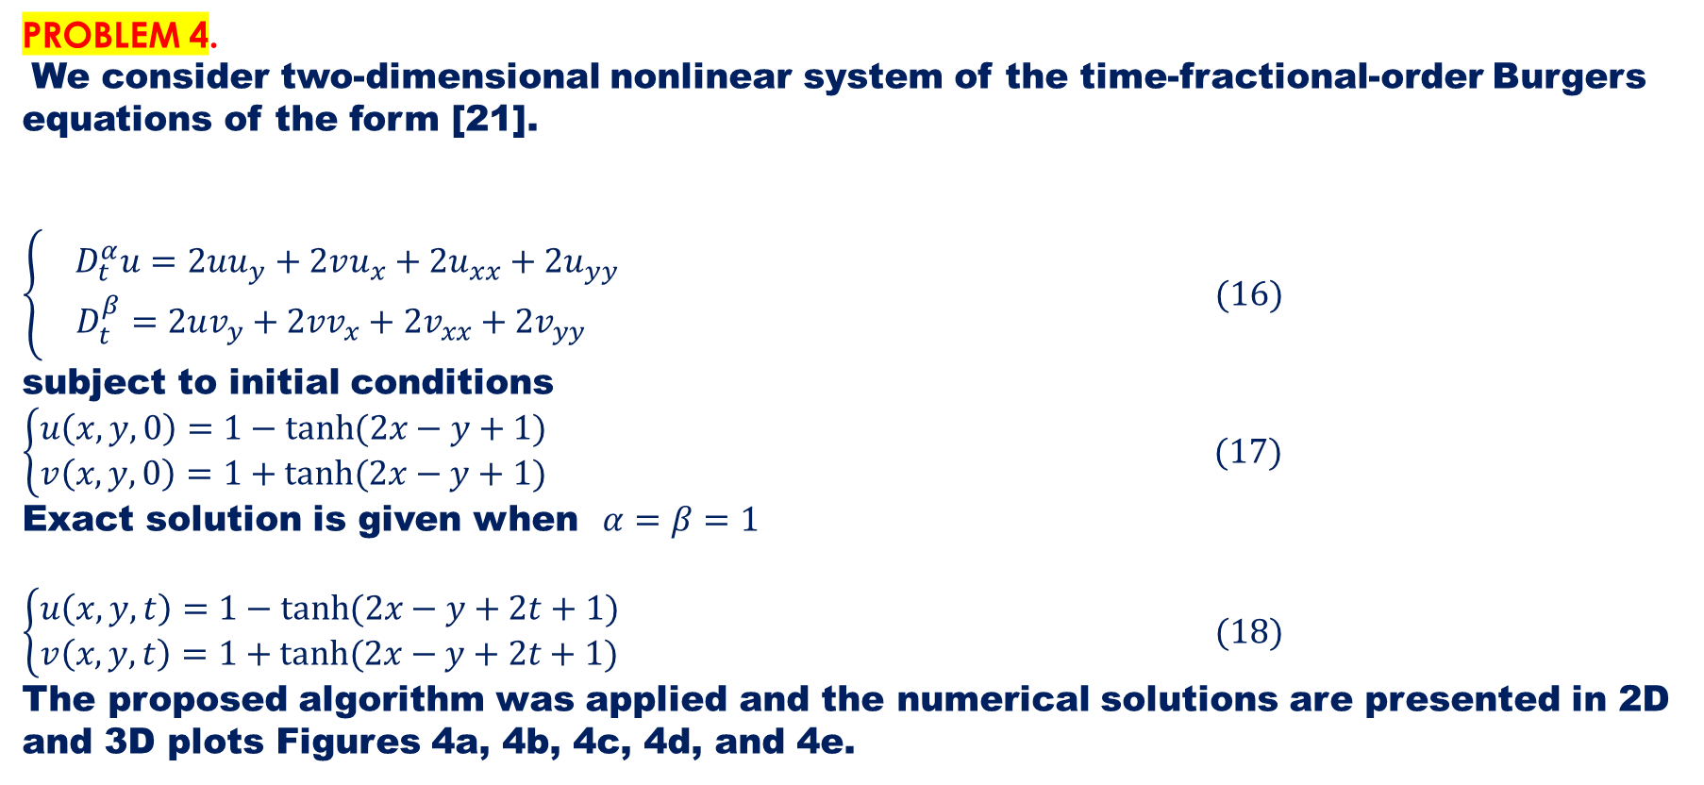
PROBLEM 4.
We consider two-dimensional nonlinear system of the time-fractional-order Burgers equations of the form [21].
$\left\{\begin{aligned}{ D}_{t}^{α}u=2uu_{y}+2vu_{x}+2u_{xx}+2u_{yy} \\ D_{t}^{β}=2uv_{y}+2vv_{x}+2v_{xx}+2v_{yy}\end{aligned}\right. (16)$
subject to initial conditions $\left\{\begin{aligned}u\left(x,y,0\right)=1−tanh⁡(2x−y+1) \\ v\left(x,y,0\right)=1+tanh⁡(2x−y+1)\end{aligned}\right. (17)$
Exact solution is given when $α=β=1$
$\left\{\begin{aligned}u\left(x,y,t\right)=1−tanh⁡(2x−y+2t+1) \\ v\left(x,y,t\right)=1+tanh⁡(2x−y+2t+1)\end{aligned}\right. (18)$
The proposed algorithm was applied and the numerical solutions are presented in 2D and 3D plots Figures 4a, 4b, 4c, 4d, and 4e.

Slide 15
6.0 GRAPHS PRESENTATION
PROBLEM 1. 2D Plots

Slide 16
PROBLEM 1. 3D Plots

Slide 17
PROBLEM 2. 2D

Slide 18
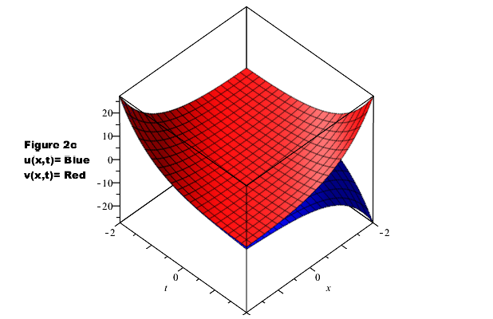
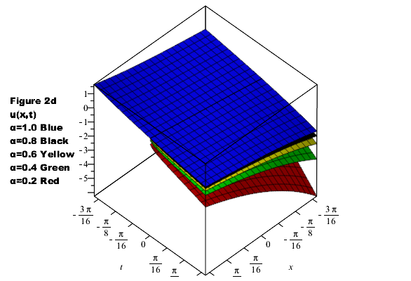
PROBLEM 2. 3D Plots

Slide 19
PROBLEM 3. 2D

Slide 20
PROBLEM 3. 3D

Slide 21
PROBLEM 4. 2D PLOTS

Slide 22
PROBLEM 4. 3D PLOTS

Slide 23
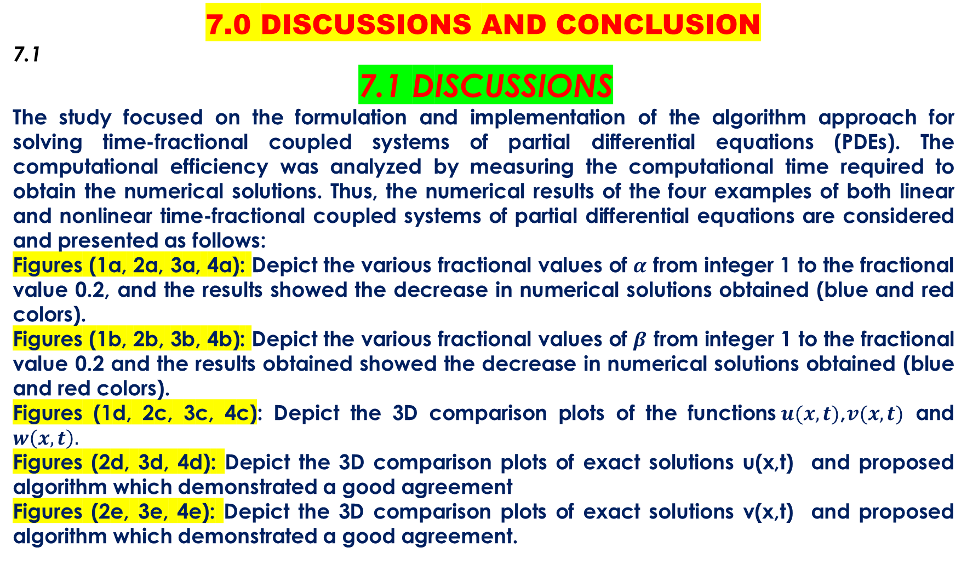
7.0 DISCUSSIONS AND CONCLUSION
7.1
7.1 DISCUSSIONS
The study focused on the formulation and implementation of the algorithm approach for solving time-fractional coupled systems of partial differential equations (PDEs). The computational efficiency was analyzed by measuring the computational time required to obtain the numerical solutions. Thus, the numerical results of the four examples of both linear and nonlinear time-fractional coupled systems of partial differential equations are considered and presented as follows:
Figures (1a, 2a, 3a, 4a): Depict the various fractional values of $α$ from integer 1 to the fractional value 0.2, and the results showed the decrease in numerical solutions obtained (blue and red colors).
Figures (1b, 2b, 3b, 4b): Depict the various fractional values of $β$ from integer 1 to the fractional value 0.2 and the results obtained showed the decrease in numerical solutions obtained (blue and red colors).
Figures (1d, 2c, 3c, 4c): Depict the 3D comparison plots of the functions$u(x,t)$,$v(x,t)$ and $w\left(x,t\right).$
Figures (2d, 3d, 4d): Depict the 3D comparison plots of exact solutions u(x,t) and proposed algorithm which demonstrated a good agreement
Figures (2e, 3e, 4e): Depict the 3D comparison plots of exact solutions v(x,t) and proposed algorithm which demonstrated a good agreement.

Slide 24
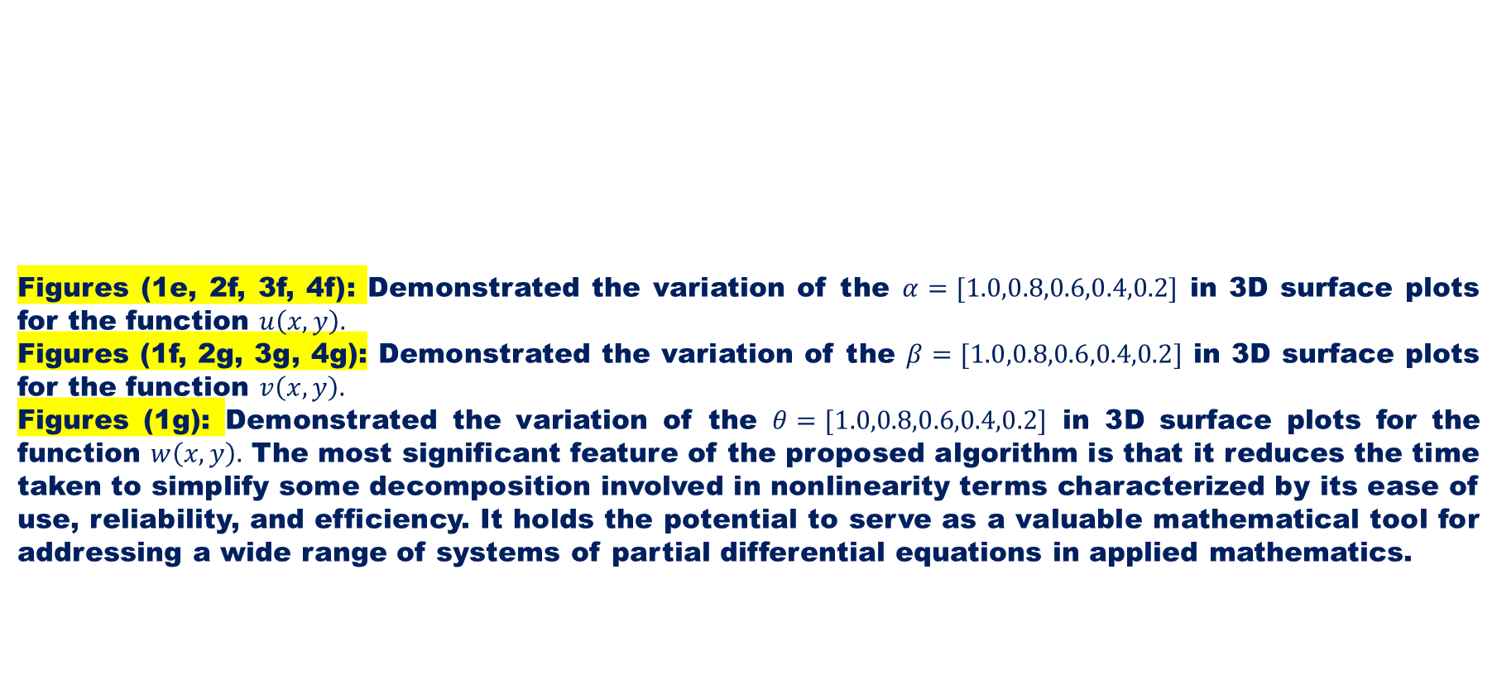
Figures (1e, 2f, 3f, 4f): Demonstrated the variation of the $α=[1.0,0.8,0.6,0.4,0.2]$ in 3D surface plots for the function $u\left(x,y\right).$
Figures (1f, 2g, 3g, 4g): Demonstrated the variation of the $β=[1.0,0.8,0.6,0.4,0.2]$ in 3D surface plots for the function $v\left(x,y\right).$
Figures (1g): Demonstrated the variation of the $θ=[1.0,0.8,0.6,0.4,0.2]$ in 3D surface plots for the function $w\left(x,y\right).$ The most significant feature of the proposed algorithm is that it reduces the time taken to simplify some decomposition involved in nonlinearity terms characterized by its ease of use, reliability, and efficiency. It holds the potential to serve as a valuable mathematical tool for addressing a wide range of systems of partial differential equations in applied mathematics.

Slide 25
7.2 CONCLUSION
This paper has demonstrated a significant advancement in the field of computation mathematics, especially in the area of time-fractional coupled systems partial differential equations. The algorithm strikes a remarkable balance between computational efficiency and accuracy by introducing new technique and integrating the best usage of Maple software package. The creation of a novel algorithm has created opportunities for additional research and use in a variety of scientific and engineering fields in addition to offering a dependable computational tool for handling challenging fractional calculus issues. This paper effectively tackles the difficult problem of solving time-fractional coupled systems of linear and non-linear partial differential equations (PDEs) and opened avenues for further exploration and application in diverse scientific and engineering domains. However, the algorithm opens new doors for exploring and understanding the intricate dynamics of real-world phenomena, ultimately advancing both computational mathematics and our capacity to model the complexities of the natural world.

Slide 26
REFERENCES
[1] Baleanu D, Diethelm K, Scalas E, Trujillo M (2012) Fractional calculus: models and numerical methods. World Scientifc Publishing Company, Singapore.
[2] Baleanu D, Machado JAT, Luo AC (2012) Fractional dynamics and control. Springer, Berlin.
[3] Kilbas A A, Srivastava H M, Trujillo JJ (2006) Theory and applications of fractional differential equations, north-holland mathematics studies, vol 204. Elsevier Science B.V, Amsterdam.
[4] Zurigat M, Momani S, Odibat Z, Alawneh A (2010) The homotopy analysis method for handling systems of fractional differential equations, Appl. Math. Model. 34 (1) pp24–35.
[5] Jafari H, Nazari M, Baleanu D, Khalique C.M (2013) A new approach for solving a system of fractional partial differential equations, Computers and Mathematics with Applications 66, pp838–843.
[6] Jena R M, Chakraverty S (2019) Residual power series method for solving time-fractional model of vibration equation of large membranes. J Appl Comput Mech 5:603–615
[7] Dehestani H, Ordokhani Y, Razzaghi M (2019) A numerical technique for solving various kinds of fractional partial differential equations via Genocchi hybrid functions. RACSAM 113:3297–3321
[8] Jena RM, Chakraverty S, Baleanu D (2019) On the solution of imprecisely defined nonlinear time-fractional dynamical model of marriage. Mathematics 7:689–70439.
[9] Ved P. D, Rajnesh K, Devendra K, Ilyas K, Jagdev Singh (2020) An efficient computational scheme for nonlinear time fractional systems of partial differential equations arising in physical sciences, Advances in Difference Equations, volume:46.
[10] Jena1 R.M, Chakraverty S (2019) On the solution of time fractional coupled system of partial differential equations, SN Applied Sciences , volume 12(1).
[11] Zhiyuan L, Xinchi H, Yikan L (2023) Initial-boundary value problems for coupled systems of time-fractional diffusion equations, Fractional Calculus and Applied Analysis, volume 26, pp533–566.

Slide 27
[12] Saud O, Abdou M.A, Abdel-Haleel A, Alharib W (2020) Numerical and approximate solutions for coupled time fractional nonlinear evolutions equations via reduced differential transform method, Chaos, Solitons & Fractals, Volume 131, pp1-14.
[13] Junesang C, Devendra K, Jagdev S, Ram S (2017) Analytical techniques for system of time fractional nonlinear differential equations, Journal korean math. soc. 54, No. 4, pp. 1209–1229.
[14] Atangana A, Alabaraoye E (2013) Solving a system of fractional partial differential equations arising in the model of HIV infection of CD4+T cells and attractor one-dimensional Keller-Segel equations, Adv. Difference Equation, Article 94, pp14.
[15] Thota S, Kumar S.D (2019) Maple implementation of a reduction algorithm for differential-algebraic systems with variable coefficients, International Conference on Recent Trends in Engineering & Technology and Quest for Sustainable Development, Institute of Technology. Ethiopia: Ambo University, pp1-16.
[16] Thota S, Kumar S.D (2016) Symbolic algorithm for a system of differential-algebraic equations, Kyungpook Math Journal, 56 (4), pp1-60.
[17] Falade K.1, AT Tiamiyu (2022) A newly formulated algorithm for the numerical solution of nonlinear Klein-Gordon equation, Journal of Nigerian Mathematical Society, Issue 1,41(1), pp13-25.
Difference Equations, volume:46, pp1-27.
[18] Falade K. I, Hadi R, Mustafa Inc, Ali A, Ibrahim M.B, Muhammad B.H, Marek K. (2023) Numerical simulation of temperature distribution of heat flow on reservoir tanks connected in series, Alexandria Engineering Journal, (66), pp785-795.
[19] Jafari H,Seifi S (2009) Solving system of nonlinear fractional partial differential equations by homotopy analysis method, Commun. Nonlinear Sci. Numer. Simul. 14, pp1962–1969
[20] Umer H, Abid K, Bibi A, Ahmet Y, Syed T, M (2013) On System of Time-Fractional Partial Differential Equations, Walailak J Sci & Tech, 10(5): pp437-448.
[21] Noufe H. A, Ravi P. A, Rasool S, Thongchai B (2021) Analysis of the Time Fractional-Order Coupled Burgers Equations with Non-Singular Kernel Operators, Mathematics, 9, 2326. https://doi.org/10.3390/math9182326

Slide 28
THANK FOR LISTENING

